Slide 1


Security of Web
-Sunita
- Bashir
- Kelvin
- Khusi
- Darpan

Slide 2
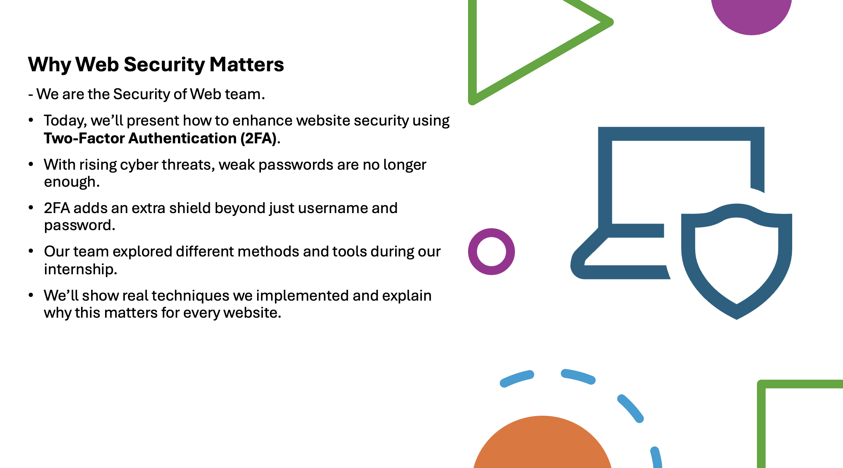

Slide 3
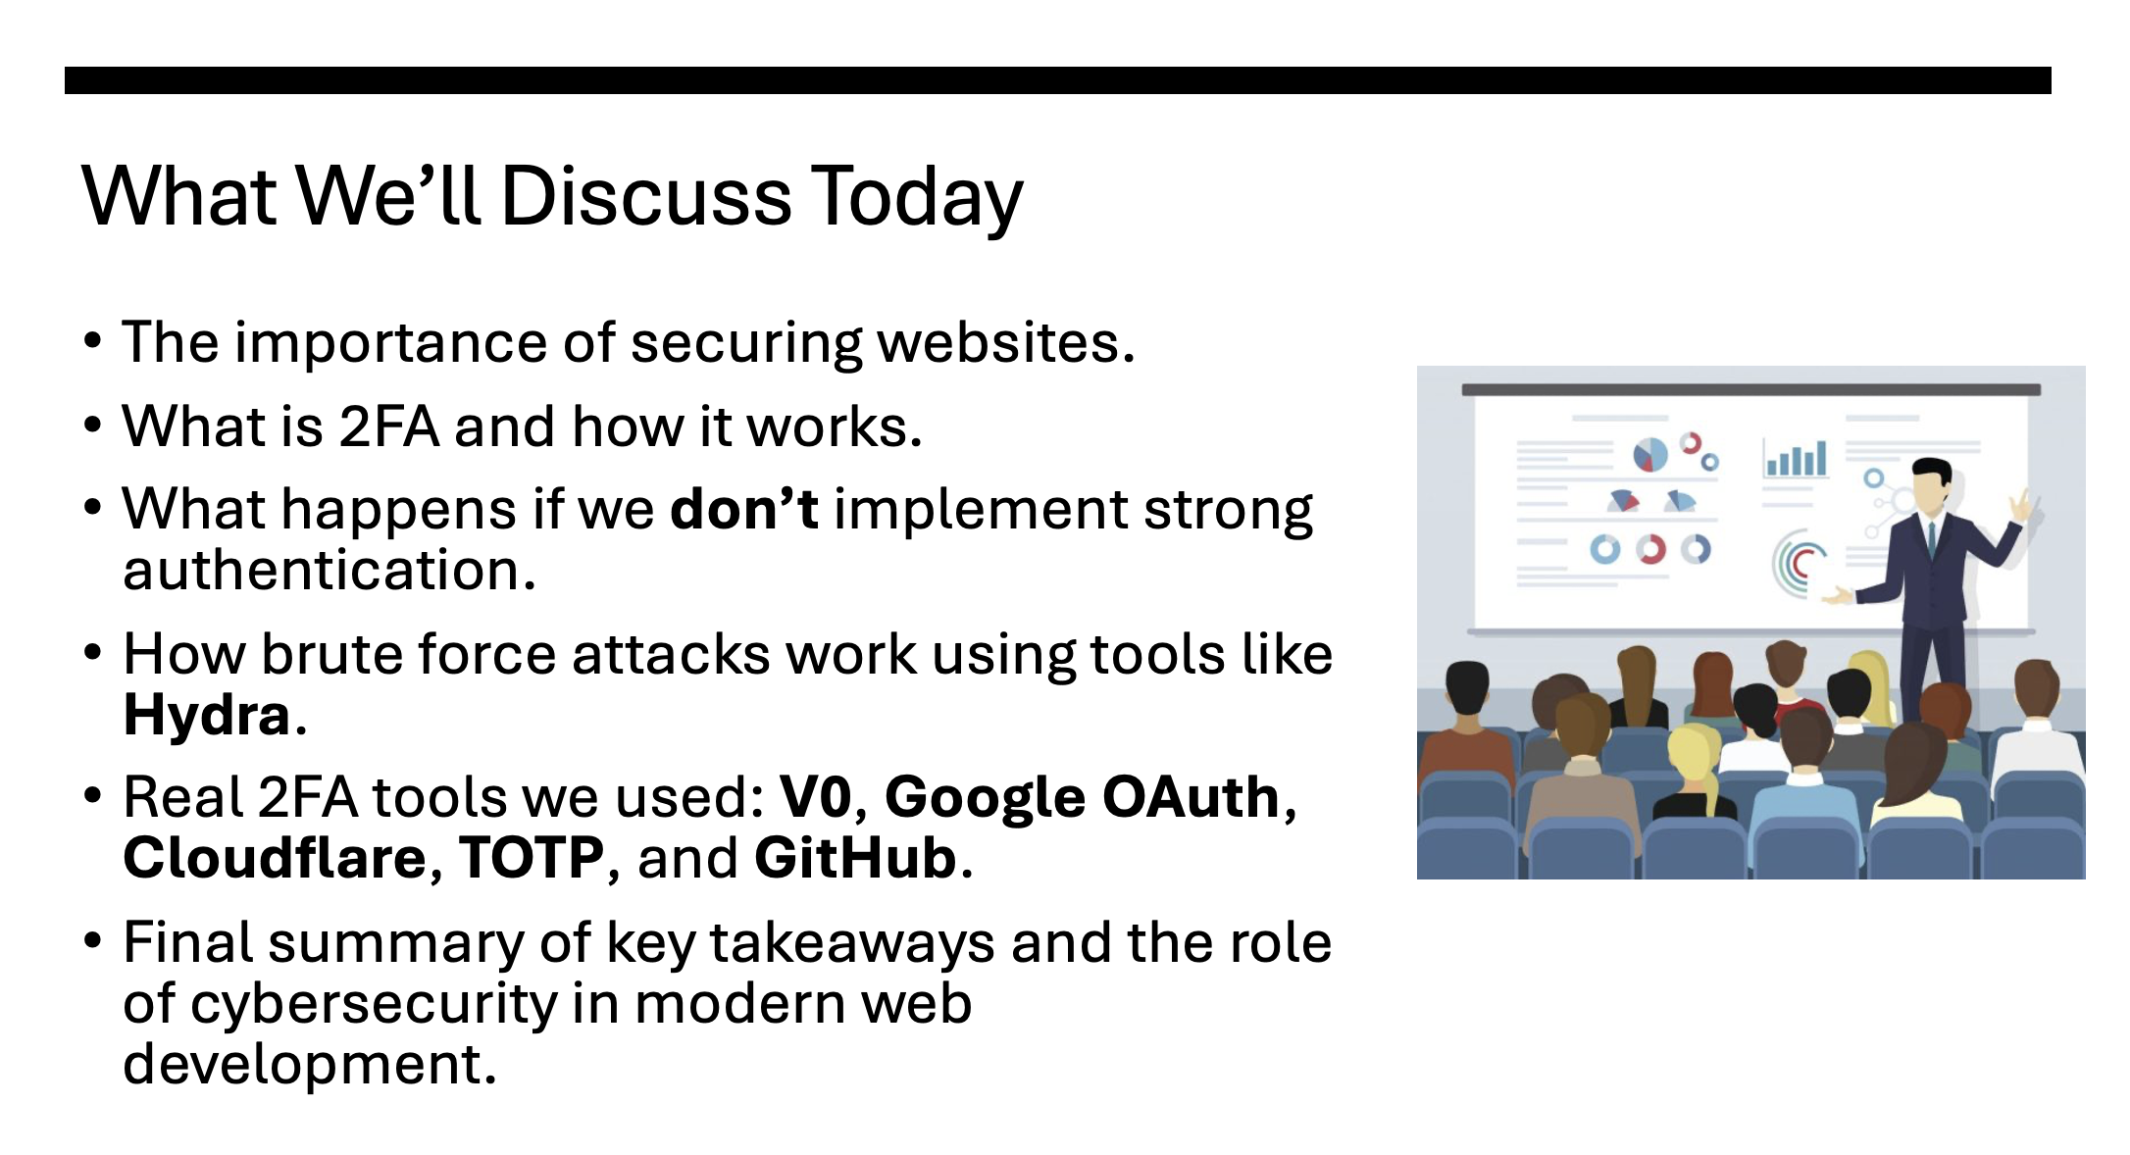

Slide 4
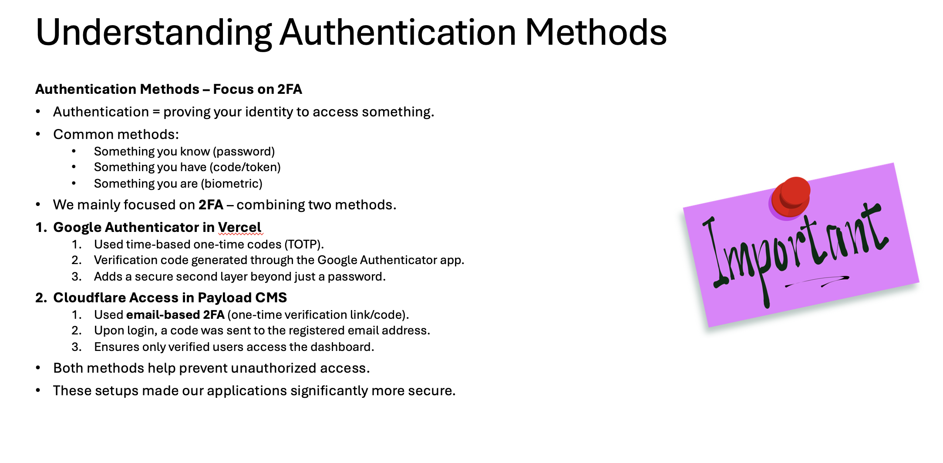

Slide 5
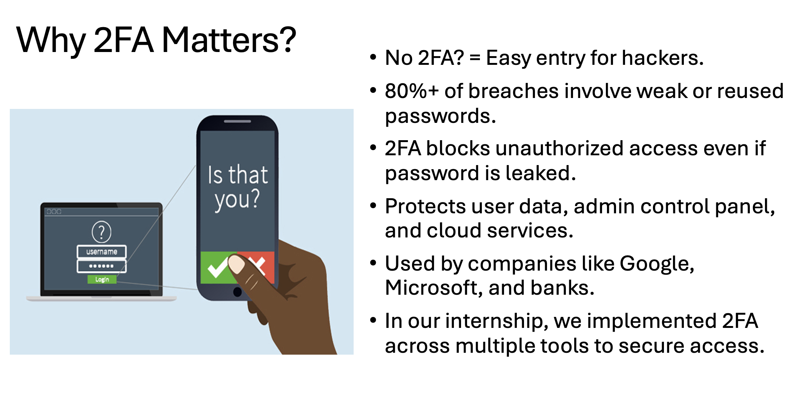

Slide 6
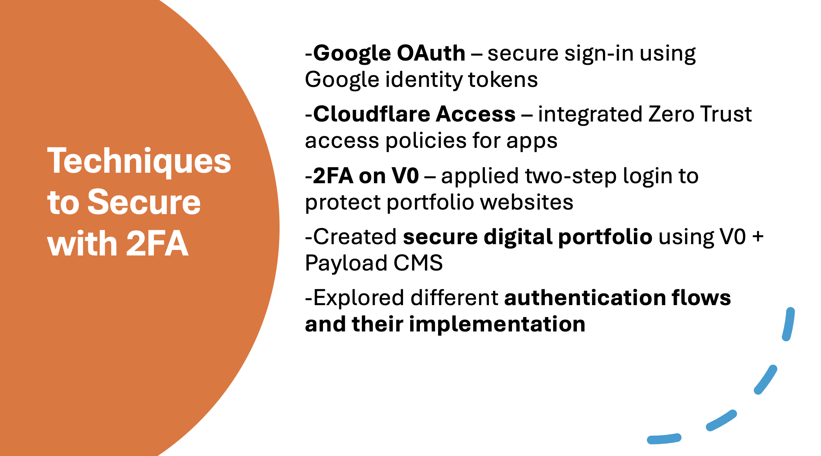

Slide 7
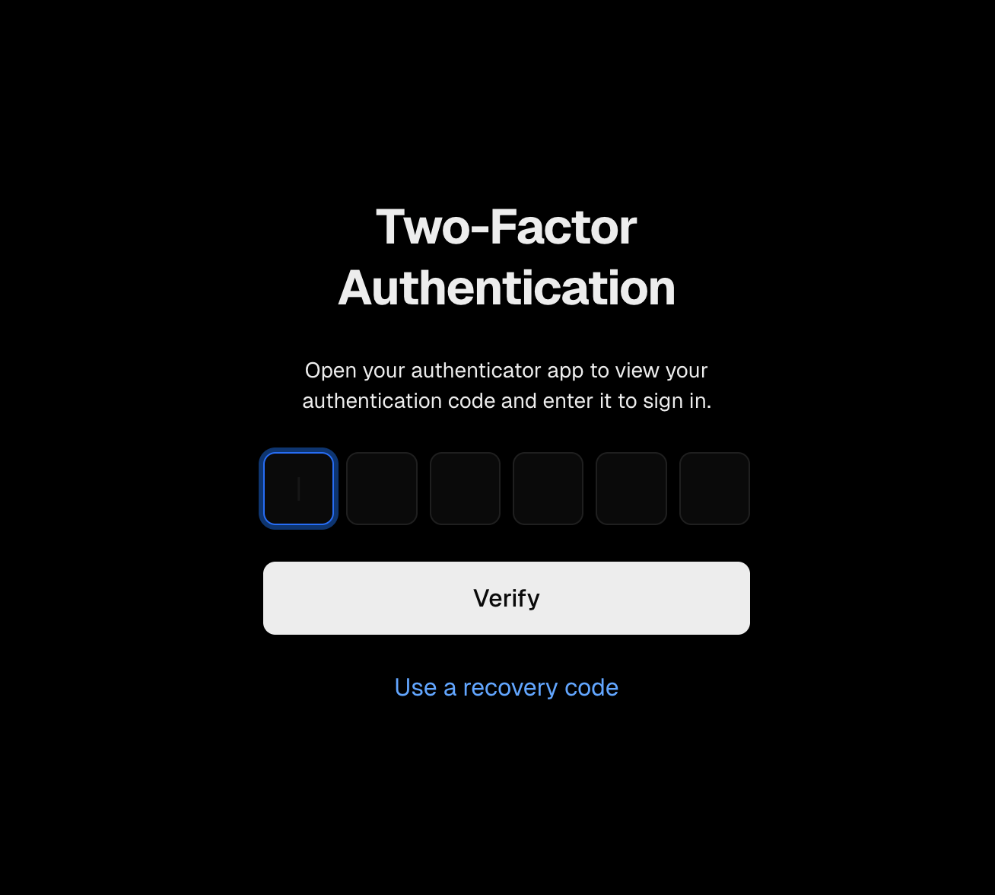
Using Google Authenticator

Slide 8
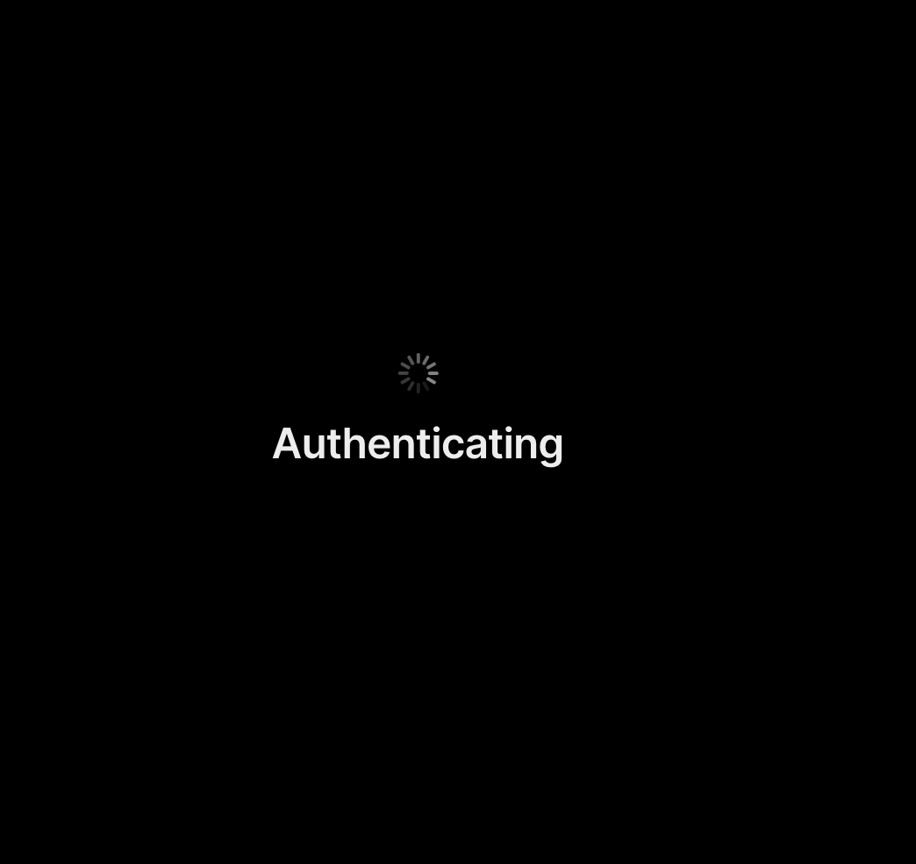
After using verification code

Slide 9
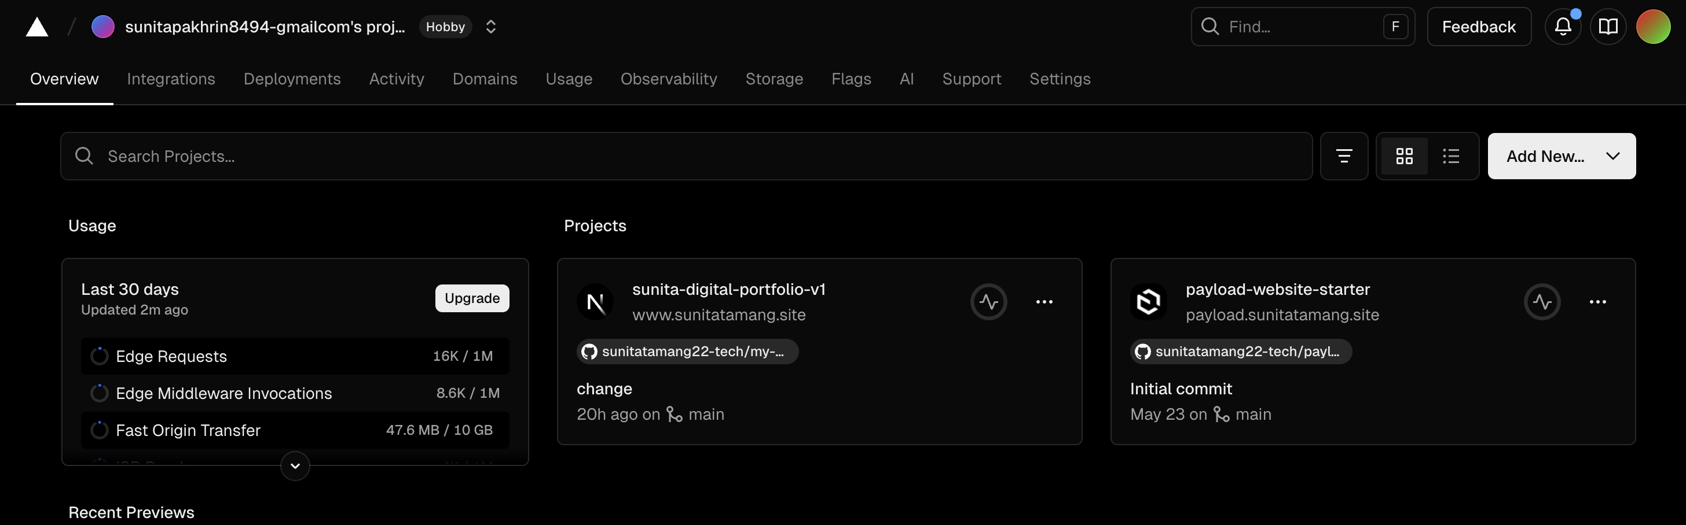
This will launch Vercel

Slide 10
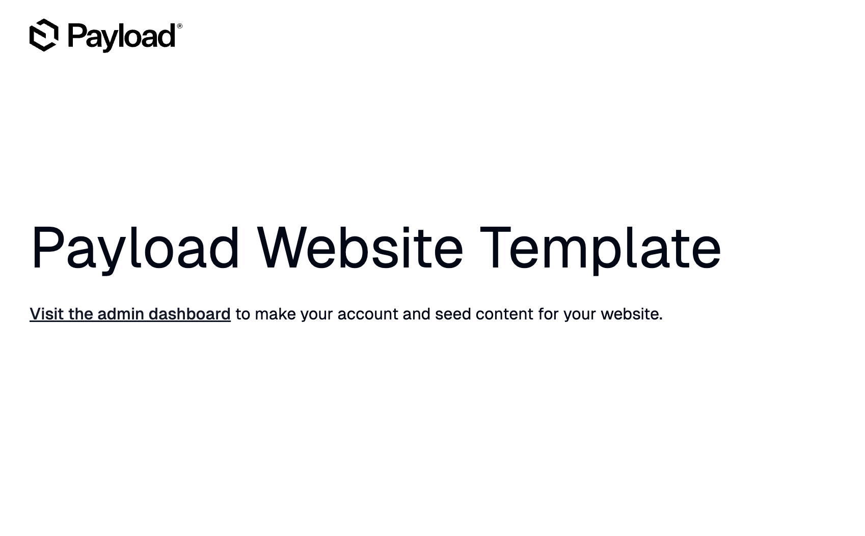
For Paycloud using Cloudfare

Slide 11
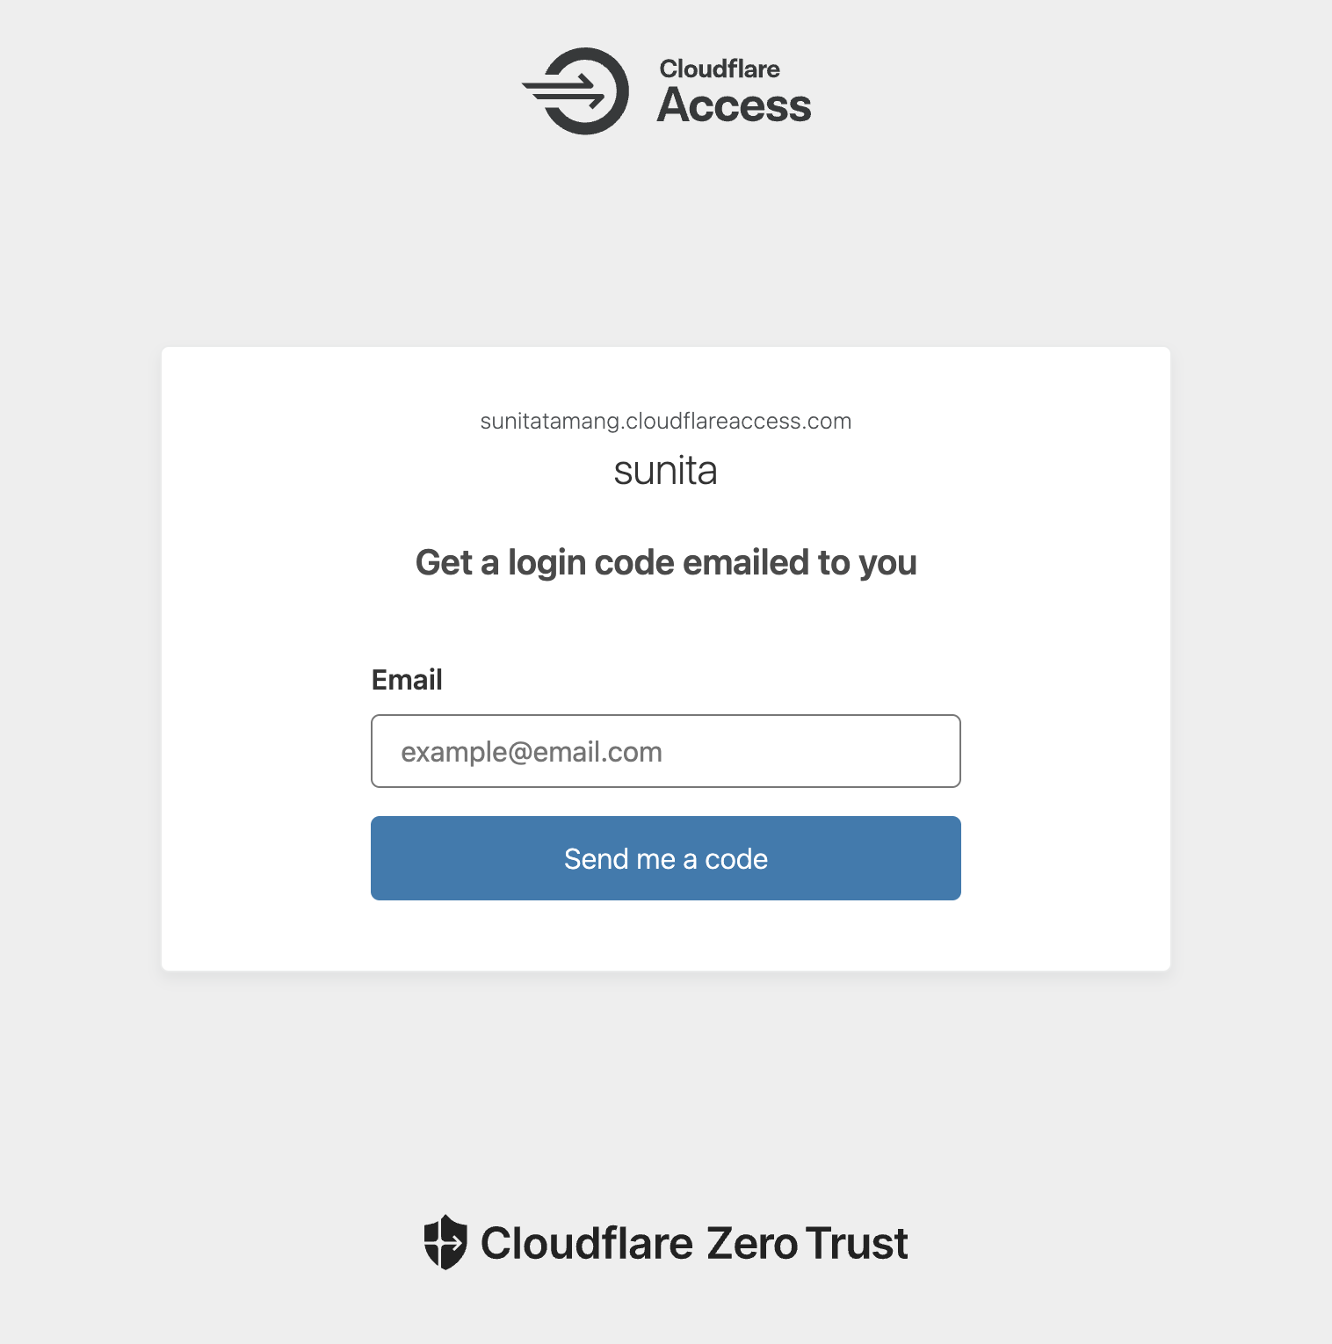
The system sends a code to your registered email

Slide 12
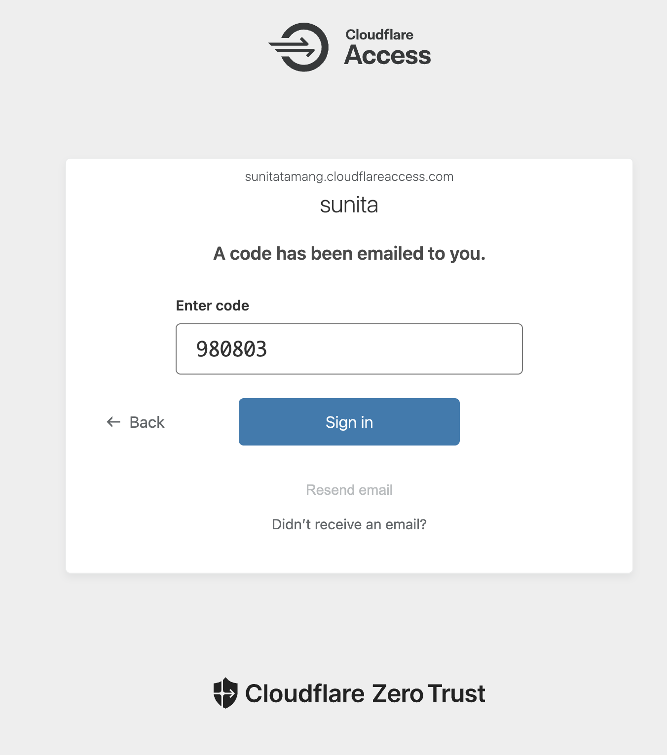
After verifying the code, you’ll be directed to Payload.

Slide 13
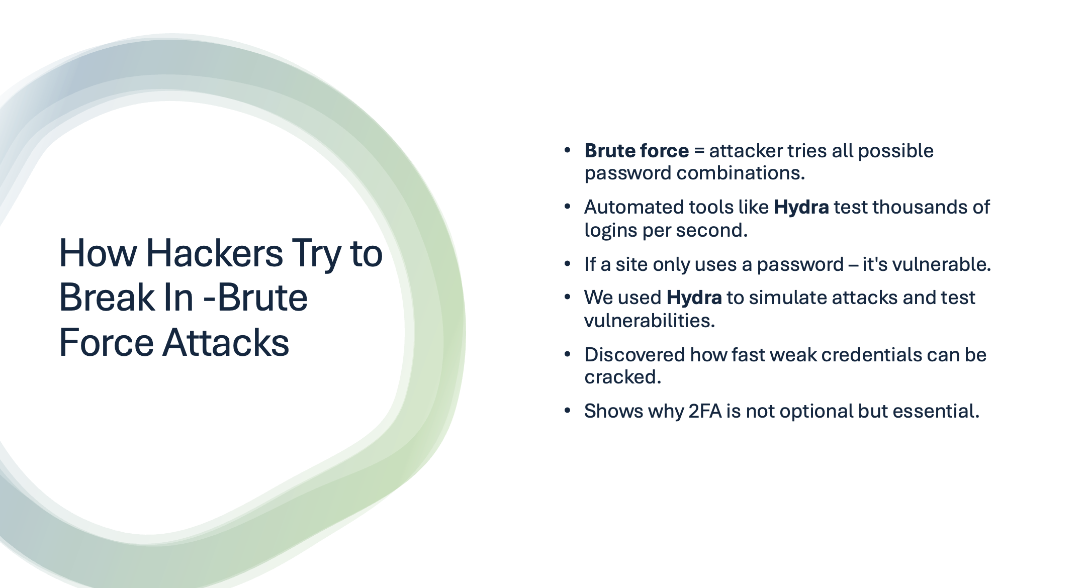

Slide 14
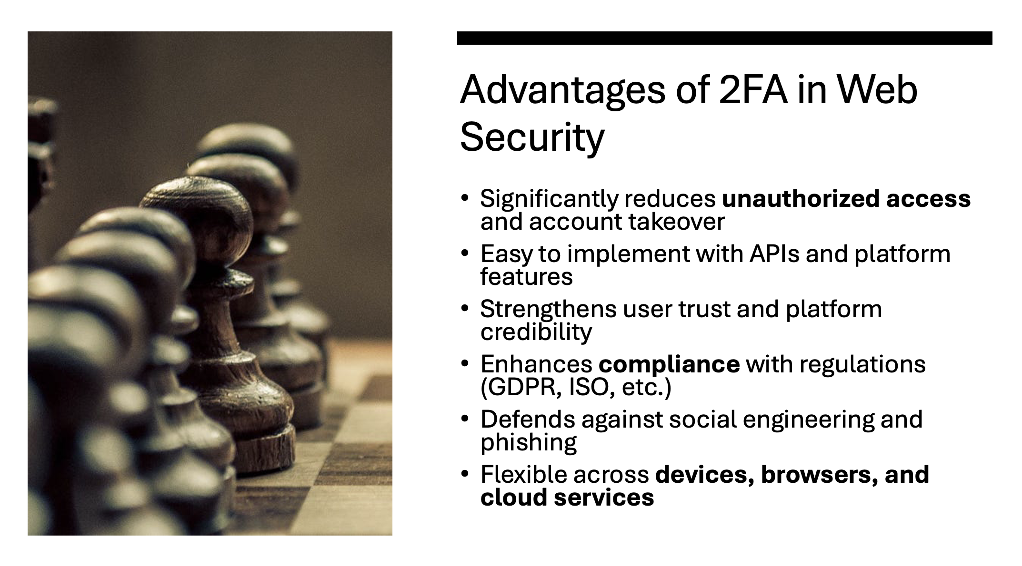

Slide 15

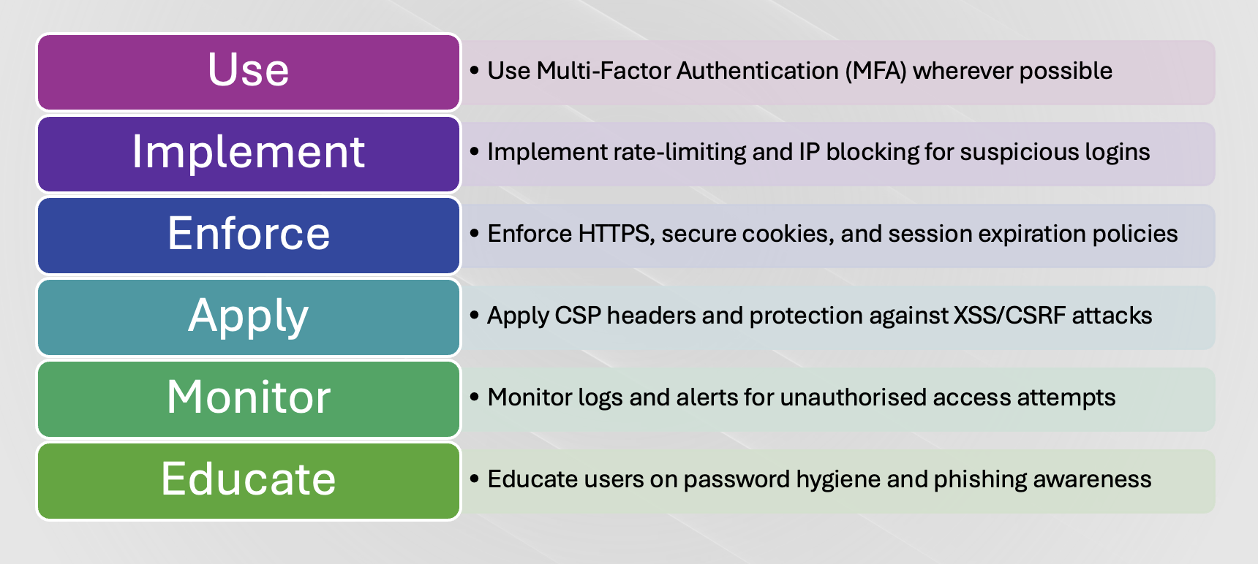
What More Can We Do to Secure the Web

Slide 16

Conclusion
Gained hands-on experience with modern 2FA tools and platforms
Strengthened understanding of web authentication frameworks
Learned to apply security concepts in real-world projects
Each team member contributed to different 2FA configurations
Built a secure personal portfolio with multi-layered protection
Ready to implement and advocate for web security best practices

